Slide 1
PURSUIT OF PRESTIGE
Luxury Clothing
Project outline by Gabe Harmon, Emerson Brown, & Chance Smits

Slide 2
Overview
Mock luxury clothing store website called “Pursuit of Prestige”
Will feature multiple webpages as part of the site
Will feature a login system and possibly a contact form
Uses HTML, CSS, JavaScript, and likely PHP

Slide 3
Key Tools
Languages
HTML
CSS
JavaScript
PHP
Programs
Github

Slide 4
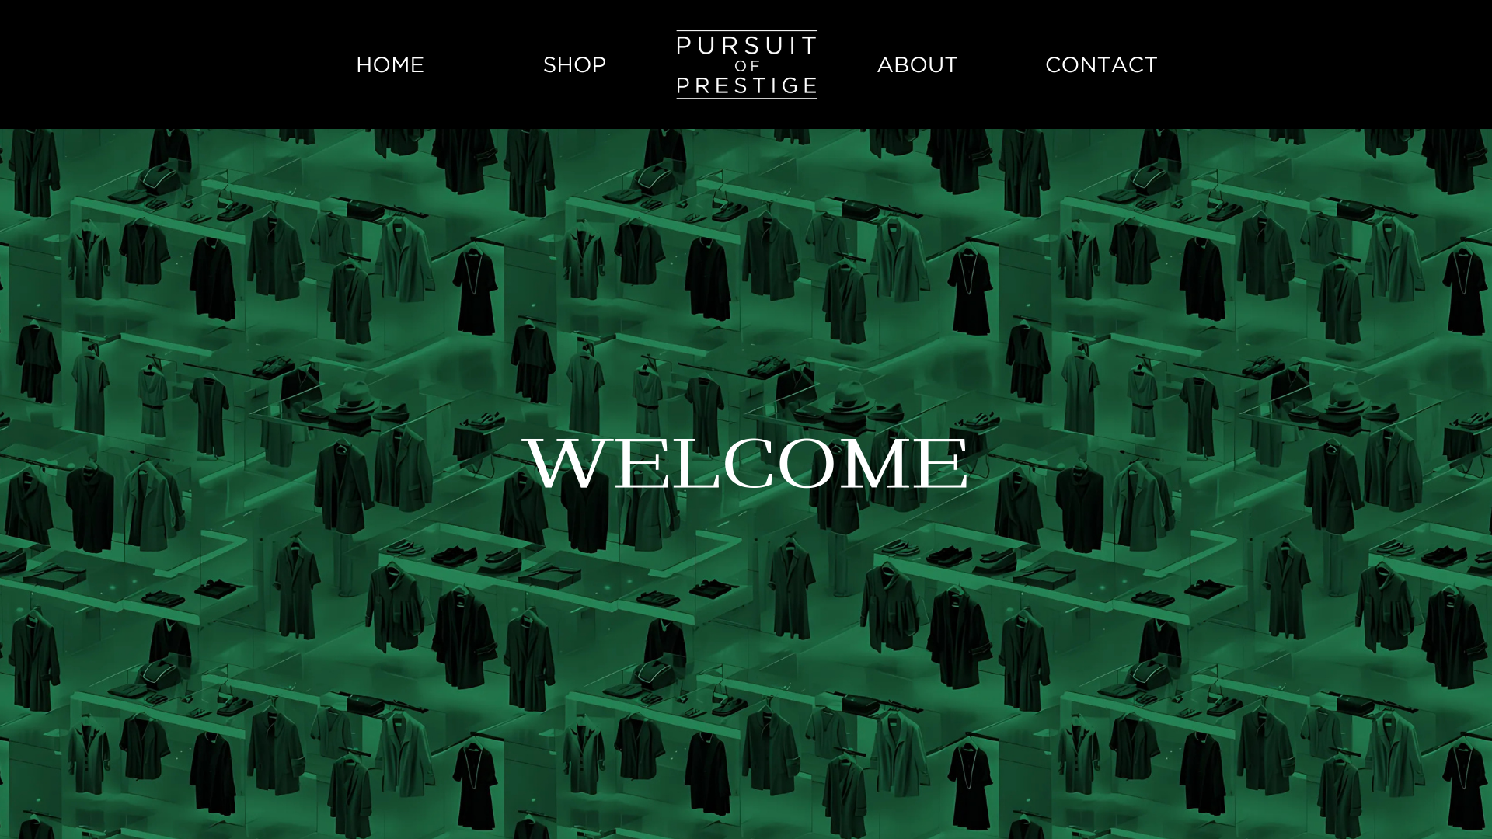

Slide 5
Main Components
Webpages
Home page
Welcoming
“Shop”
Mocked for demonstration
About Page
Contact Page
PHP form backend
HTML form frontend
Create an account
PHP login

Slide 6
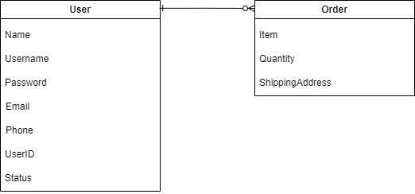
Entity-Relationship Diagram

Slide 7
Example User Stories
“As a user, I want a user account that I can use to purchase clothing so that I can log on to the website in the future and have my prior browsing, deals, and other activity saved”
“As a employee, I want a visual of my employee status within the organization so that I can track my pay and other information regarding my employment”

Slide 8
Developer Experience
Gabe
Strong front-end/visual experience
Intermediate backend experience
Front/backend project experience
Emerson
Strong front end/debugger experience
Average backend experience
Chance
Intermediate backend experience
Project planning/documentation experience
Networking experience

